Slide 1
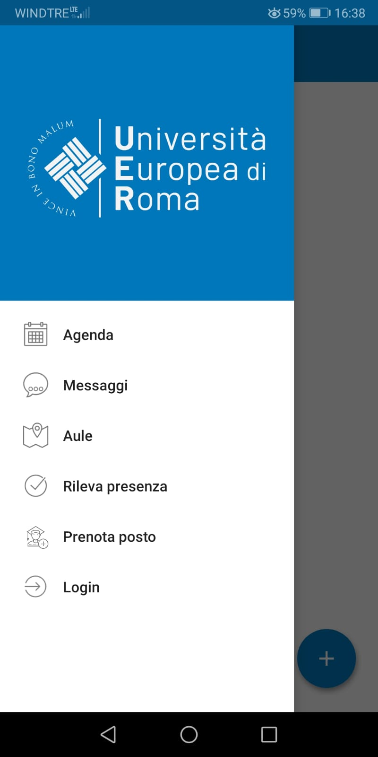
UERCLASS App
Fare clic per inserire testo
Fare clic per inserire testo

Slide 2
UERCLASS is the smartphone app (Android and iOS) used for registering lesson attendance and checking lesson schedules.
You can download UERCLASS App for free from Google Play Store and Apple Store

Slide 3
Principal functionalities
Schedules (Agenda): check lesson schedules
Notices (Messaggi): receive lesson news and notices
Classrooms (Aule): check available classrooms to study
Lesson attendance registration (Rileva presenza): register your lesson attendance
Book a spot (Prenota posto): to attend lessons in person.

Slide 4
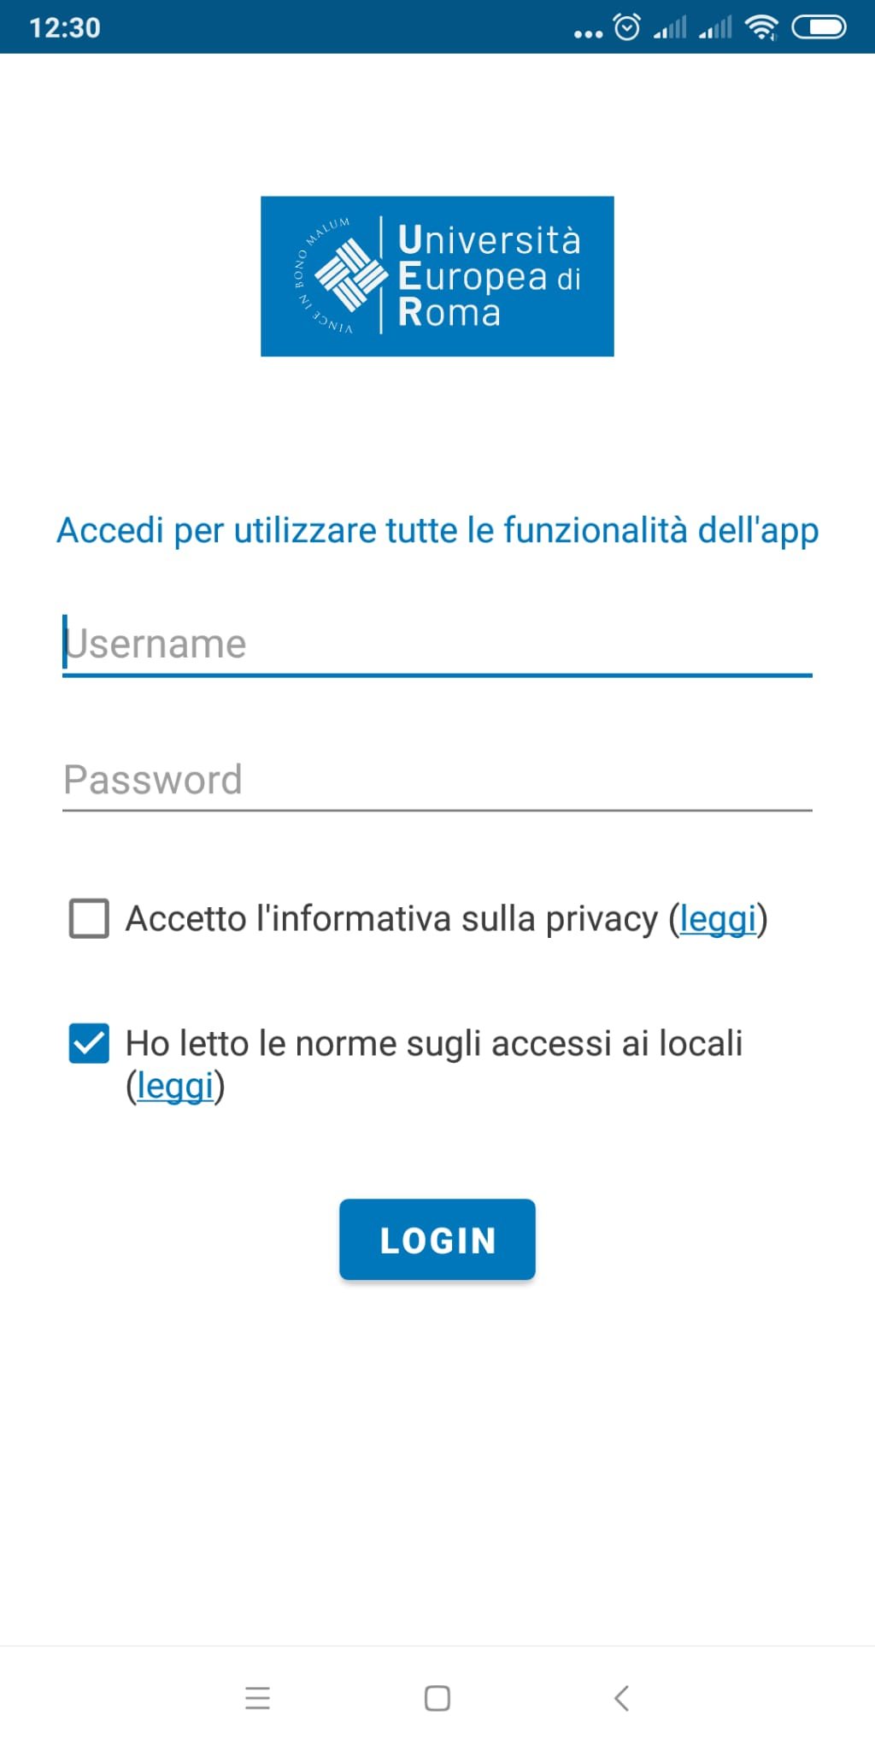
Log in
Use your Esse3 credentials

Slide 5
Create an «Erasmus» profile
Click on the blue cross> Click on the blue cross again > Didattica UNIER

Slide 6
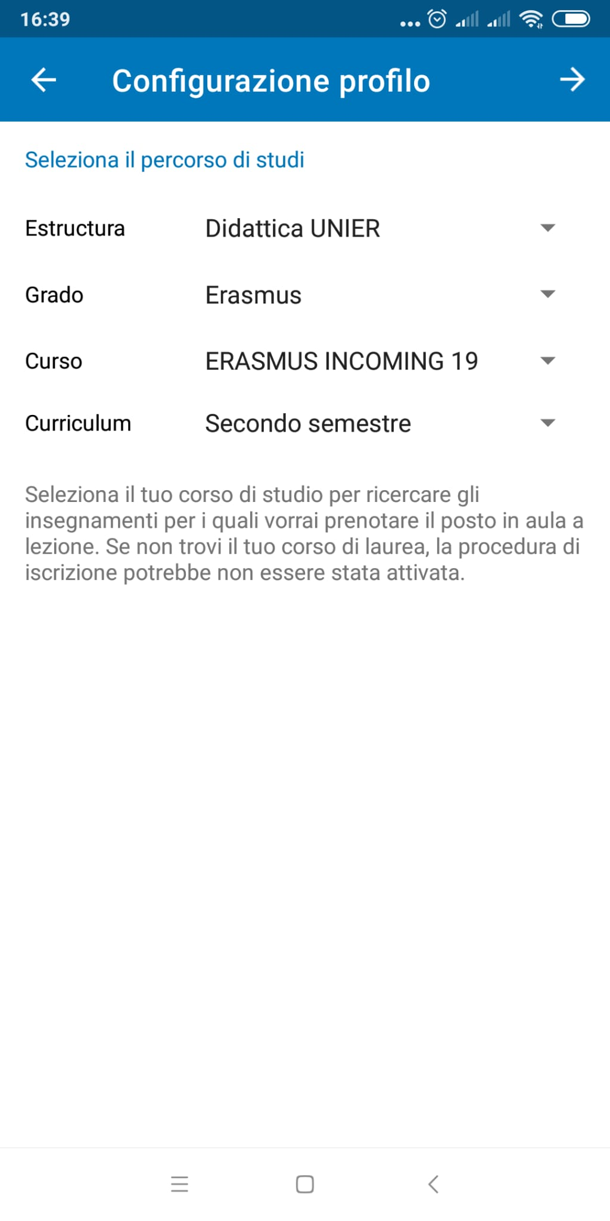
Create an «Erasmus» profile
Department: Didattica UNIER
Degree: Erasmus
Course: ERASMUS INCOMING 19
Curriculum: Secondo semestre
Click on the arrow at the upper right corner

Slide 7
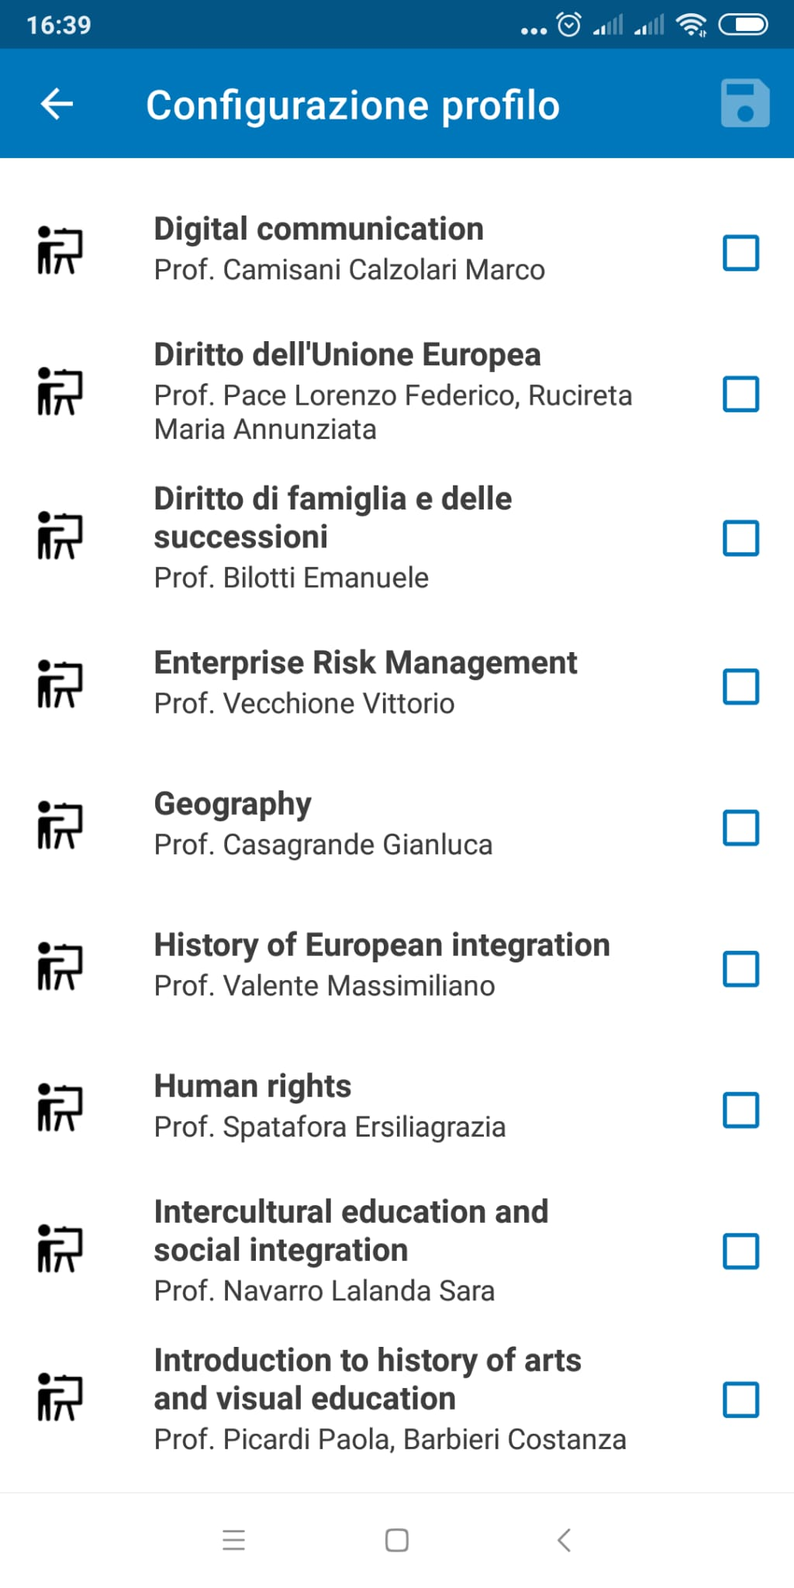
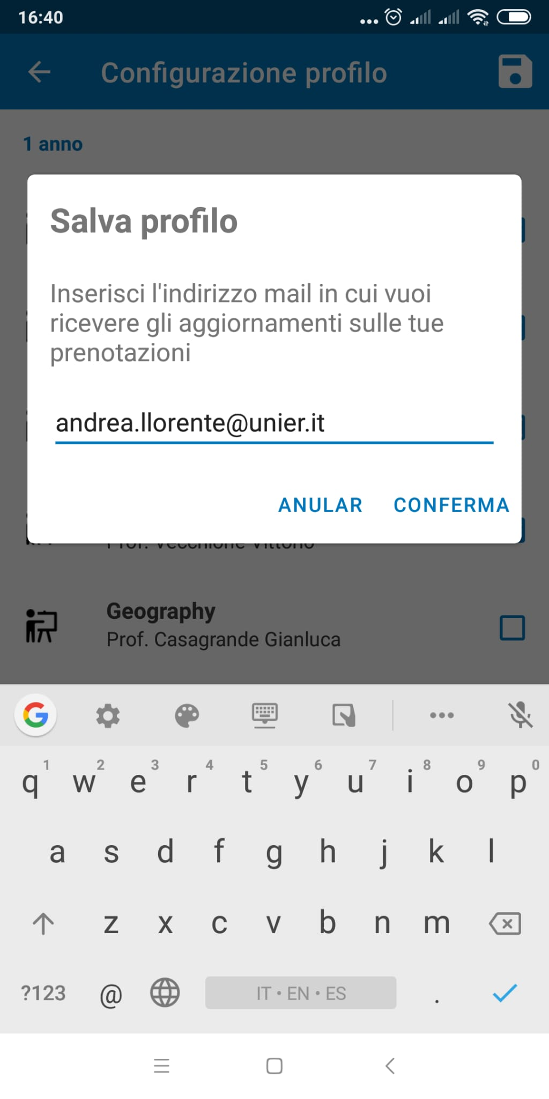
You will see the complete list of courses selected by international students.
If you need a course that is not included in the list, please send an e-mail to andrea.llorente@unier.it
Insert your e-mail and click on «conferma»

Slide 8
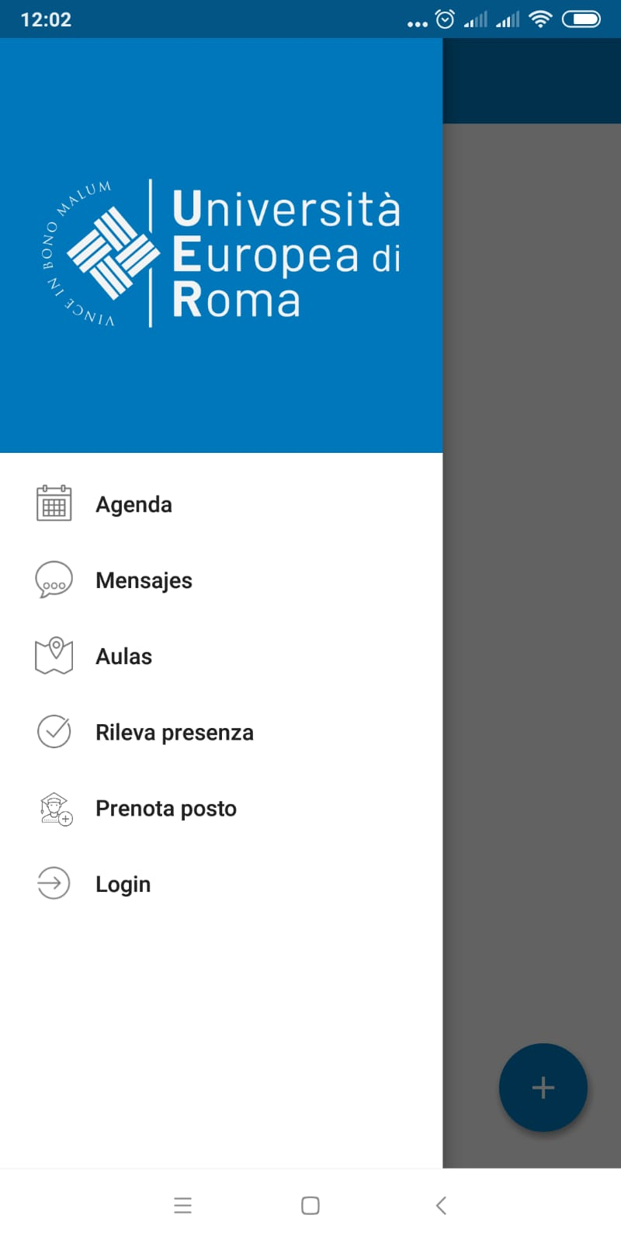
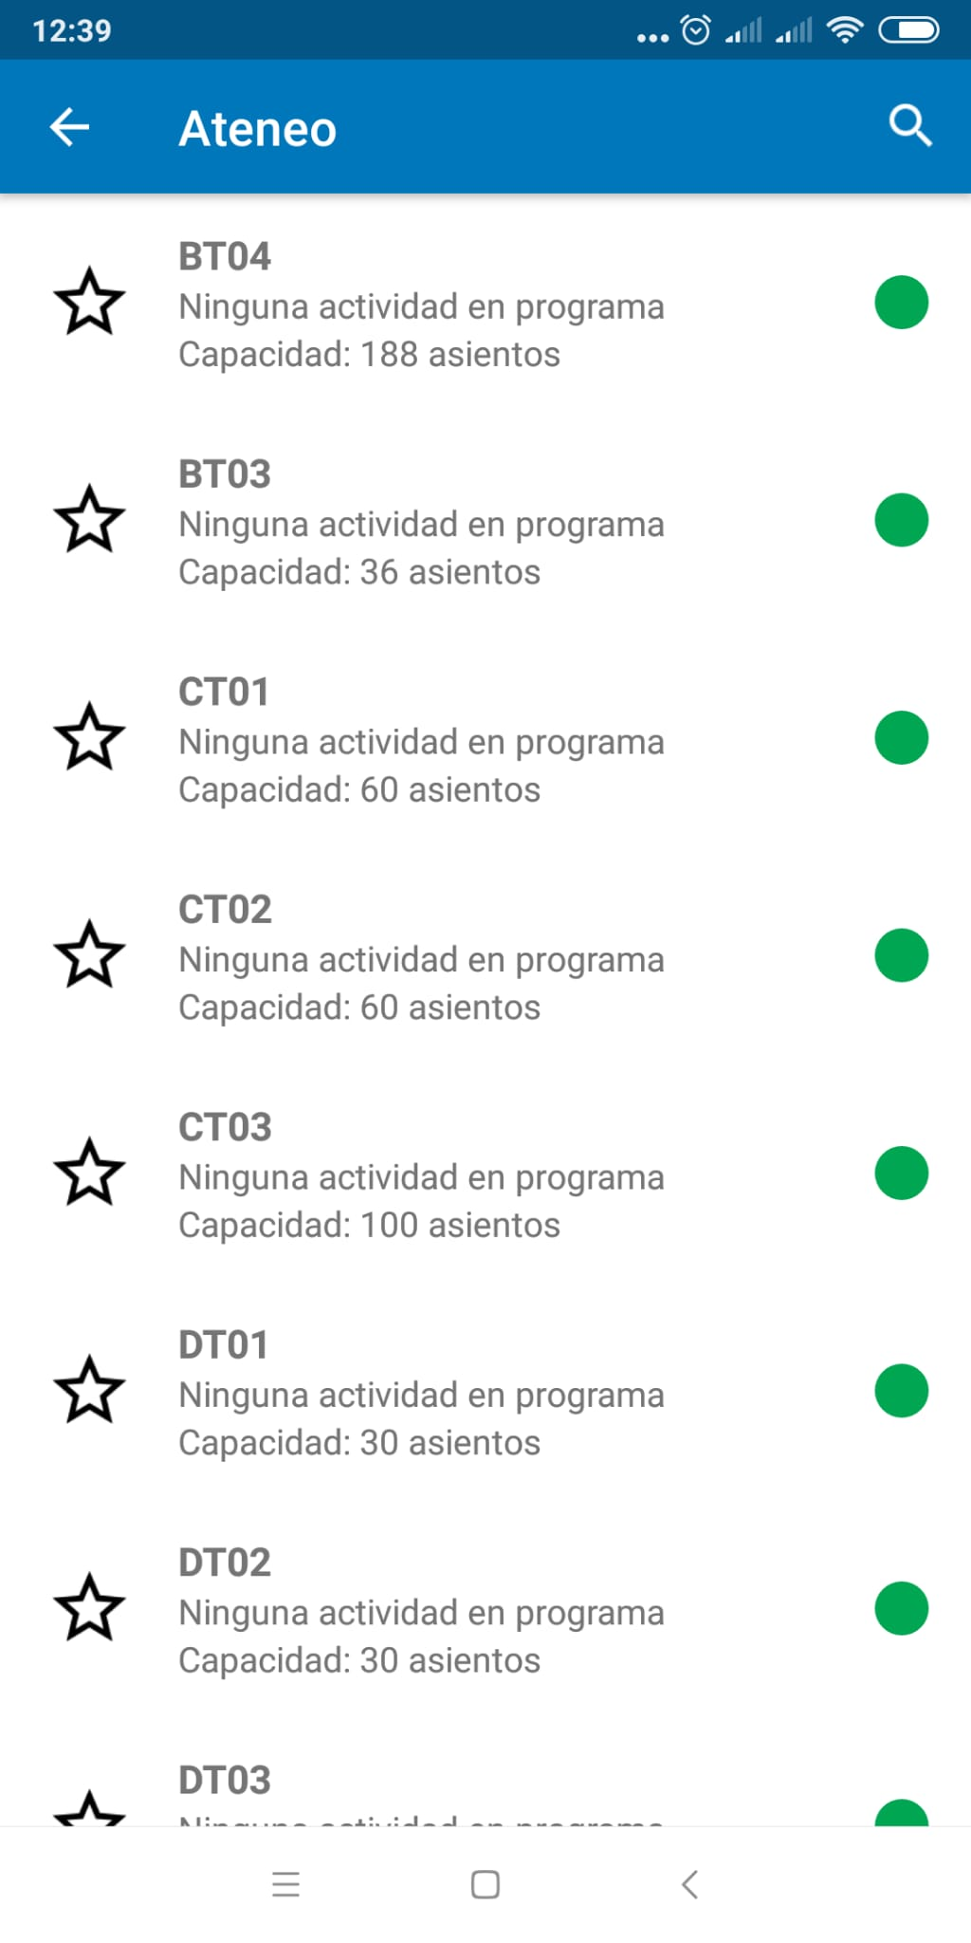
Classrooms (Agenda)

Slide 9
Lesson attendance registration (Rileva presenza)
66% compulsory attendance
Insert your matriculation number
Scan valid QR code
One lesson registration per device

Slide 10
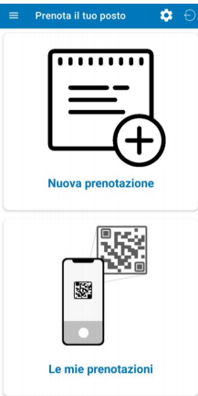
Booking a spot (Prenota posto)

Slide 11
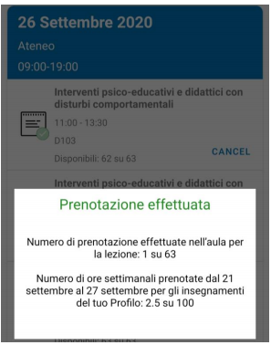
Booking a spot (Prenota posto)
It is only possible to book a spot for lessons taking place in the next 7 days.
It will not be possible to book a spot when the max. capacity of the room has alredy been reached.
You will receive an e-mail confirming your booking. You can also check your booking in «Le mie prenotazioni».

Slide 12
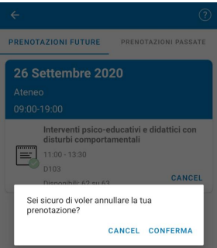
Booking a spot (Prenota posto)
You will be able to cancel your booking by clicking on «Cancel»
You cannot cancel the booking of a lesson taking place the same day.

