Slide 1
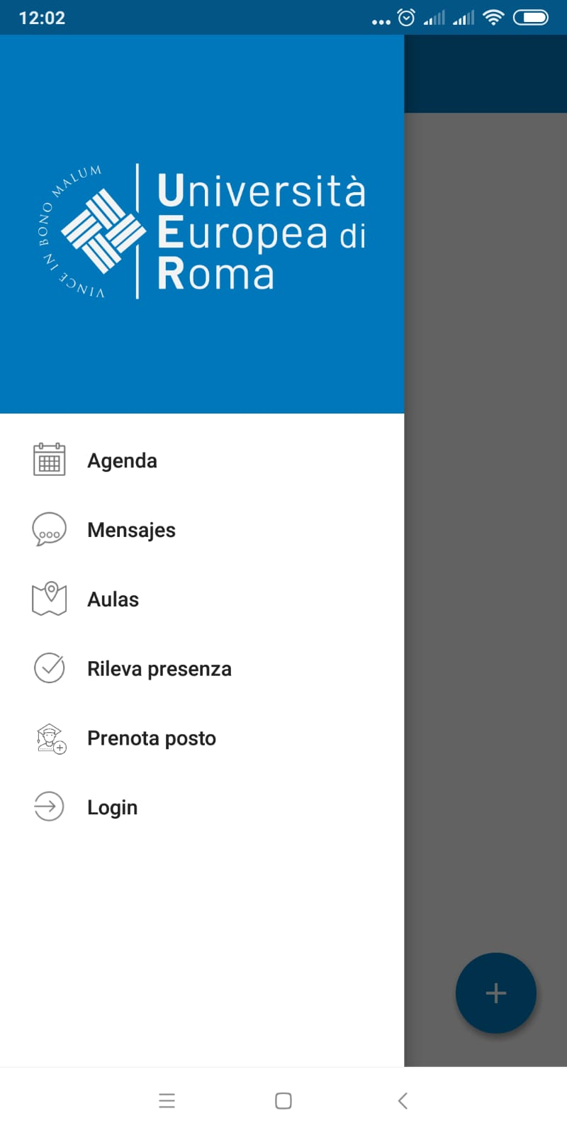
Università Europea di Roma
UERCLASS App presentation
Fare clic per inserire testo
Fare clic per inserire testo

Slide 2
UERCLASS App
Smartphone App
UERCLASS is the smartphone app (Android and iOS) used for registering lesson attendance and checking lesson schedules.
You can download UERCLASS App for free from Google Play Store and Apple Store

Slide 3
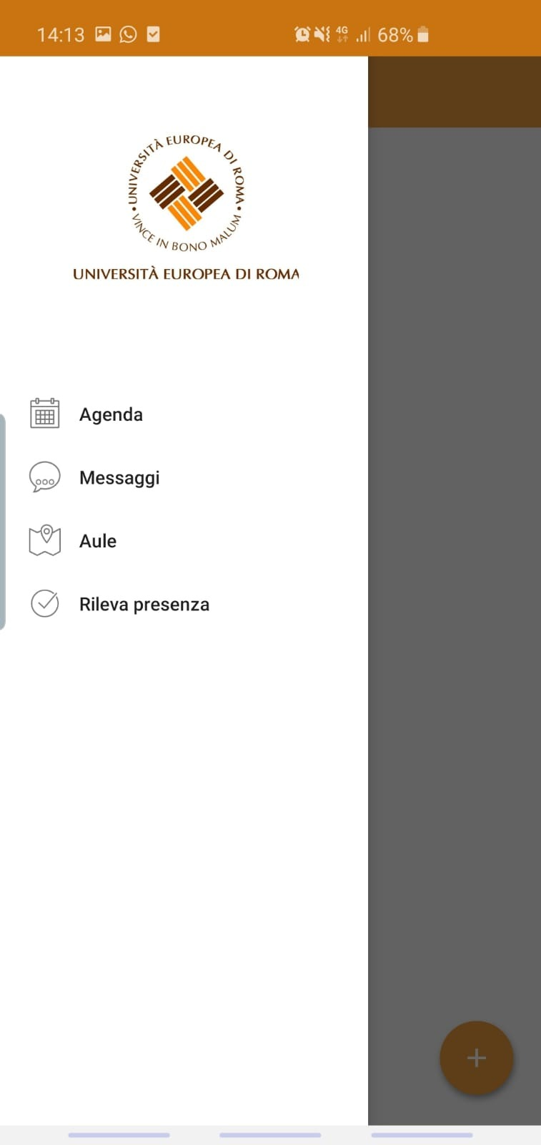
UERCLASS App
PRINCIPAL FUNCTIONALITIES
SCHEDULES: check lesson schedules directly from your smathphone.
NOTICES: receive lesson news and notices.
CLASSROOMS: check available classrooms to study.
LESSON ATTENDANCE REGISTRATION: register your lesson attendance registration from your smartphone.
BOOK A SPOT

Slide 4
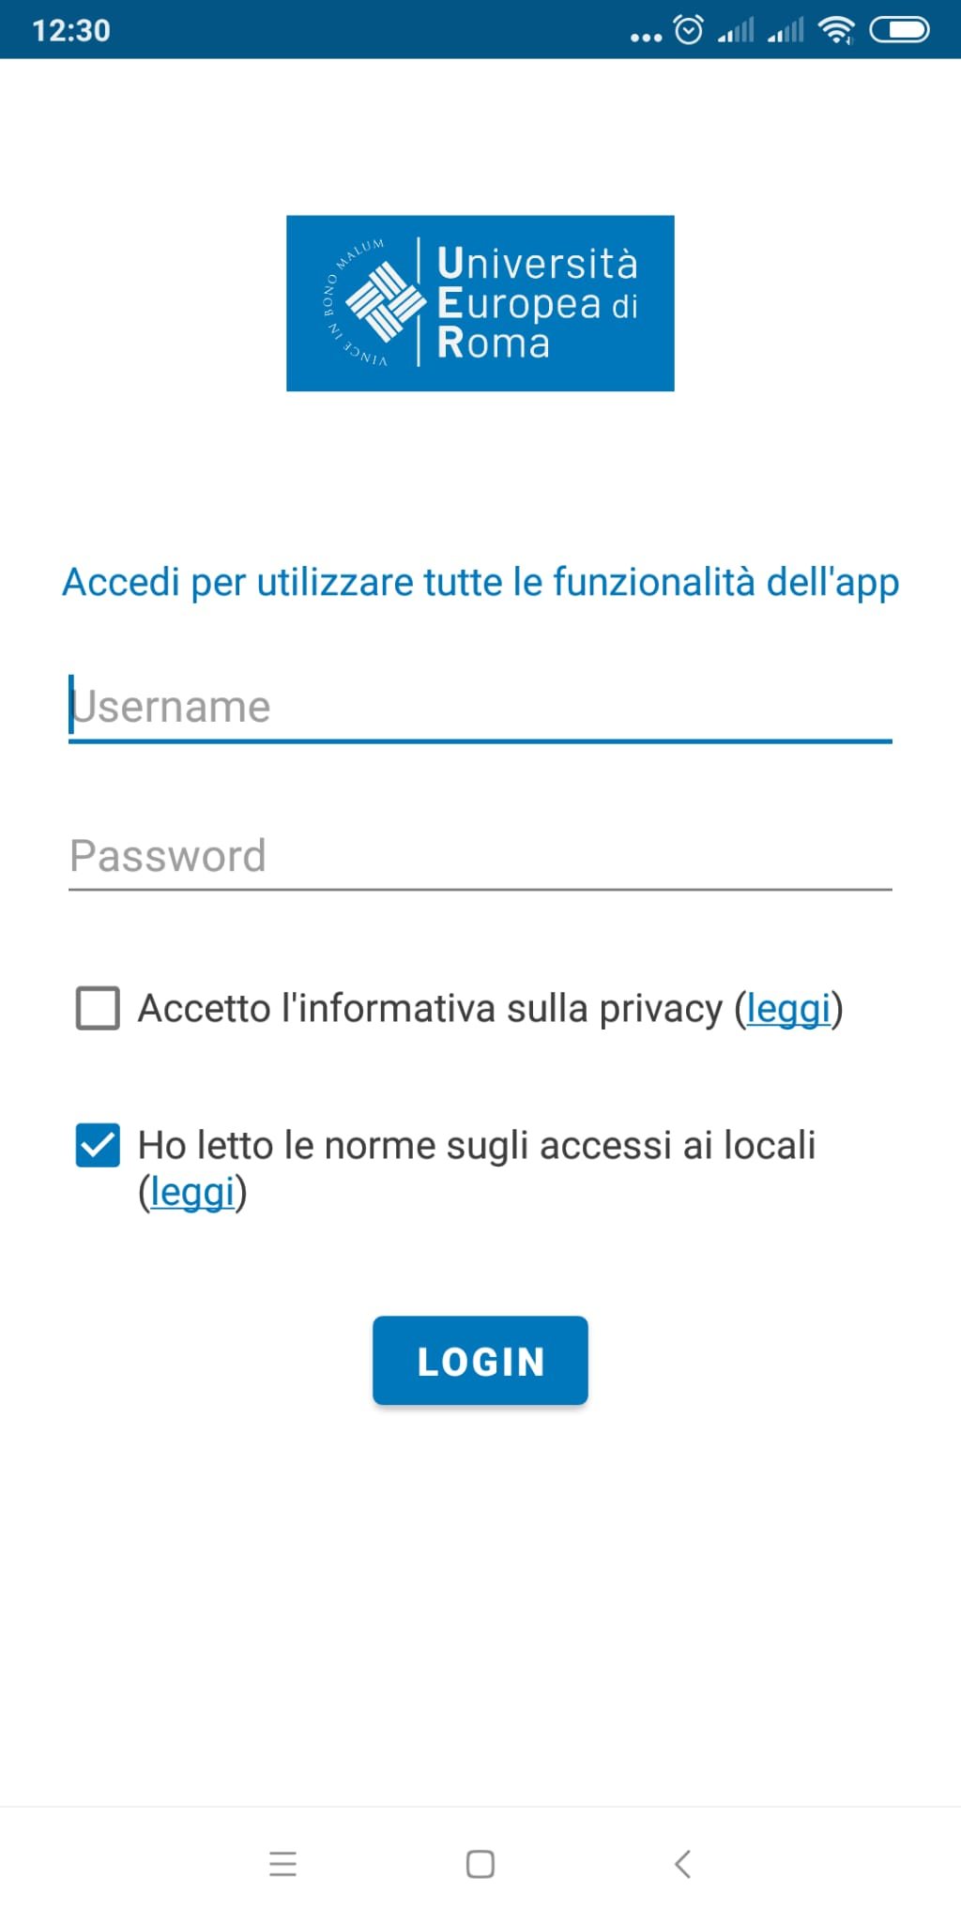
Log in
Use your Esse3 credentials

Slide 5
Create a profile
Create a profile (Law student, Economics student, etc.)
Should you attend subjects from different faculties, create different profiles
You will be able to check the schedules and notices of the selected subjects

Slide 6
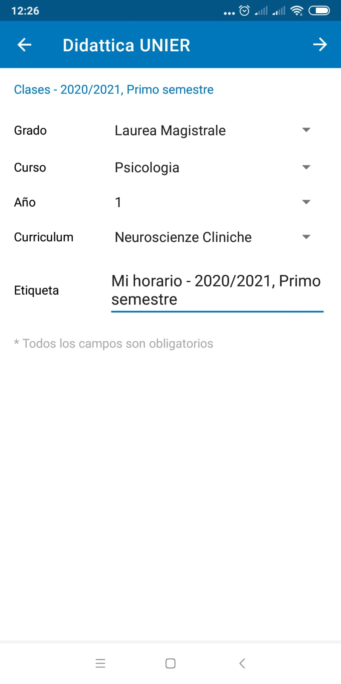
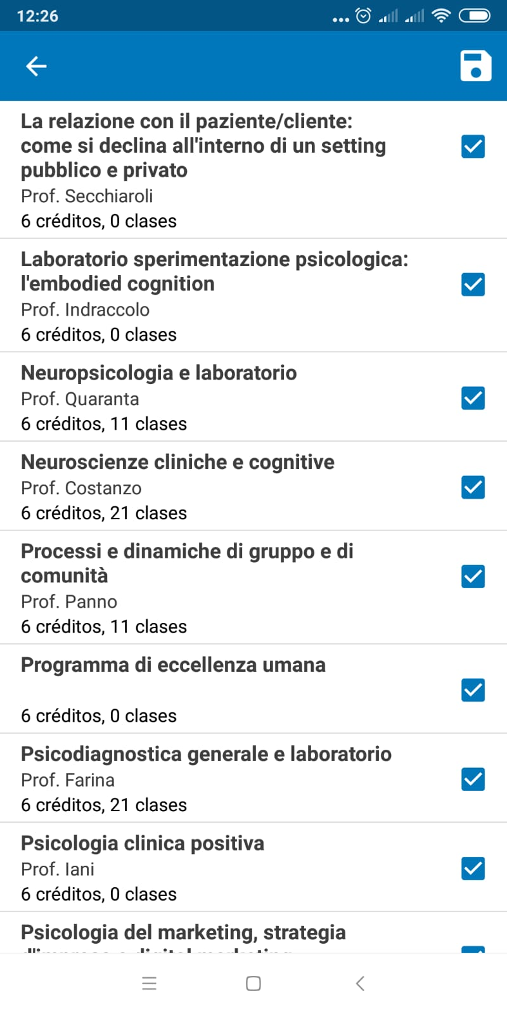
Create a profile

Slide 7
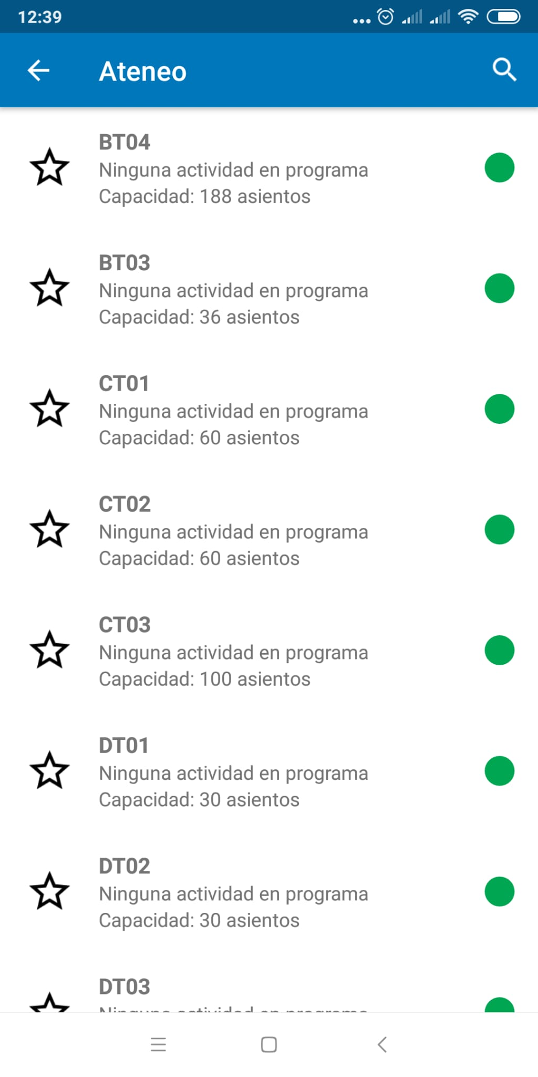
Classrooms

Slide 8
Lesson attendance registration
66% compulsory attendance
Insert your matriculation number
Scan valid QR code
One lesson registration per device

Slide 9
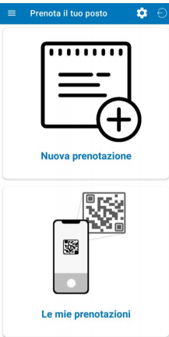
Booking a spot

Slide 10
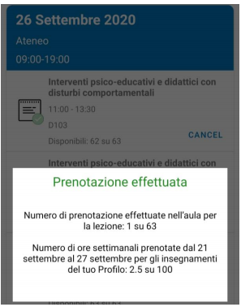
Booking a spot
It is only possible to book a spot of lessons taking place within 7 days.
It will not be possible to book a spot when the max. capacity of the room has alredy been reached.
You will receive an e-mail confirming your booking. You can also check your booking in «Le mie prenotazioni».

Slide 11
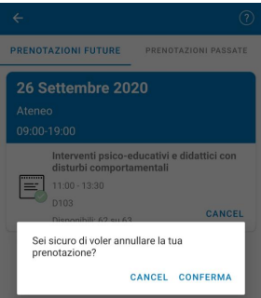
Booking a spot
You will be able to cancel your booking by clicking on «Cancel» «Conferma»
You cannot cancel the booking of a lesson taking place the same day.

